Slide 1
HOTEL MANAGEMENT SYSTEM

Slide 2
Contents
Introduction
ERR Diagram
Tables & Relationships
Queries, Views, Triggers

Slide 3
Introduction
The main objective of this project is to create a Database Management System for a Hotel.
This project is based on MySQL queries and triggers. We used Python to access the Procedures and Triggers using numbers through a User Interface instead of manually typing down the queries.

Slide 4
err diagram

Slide 5
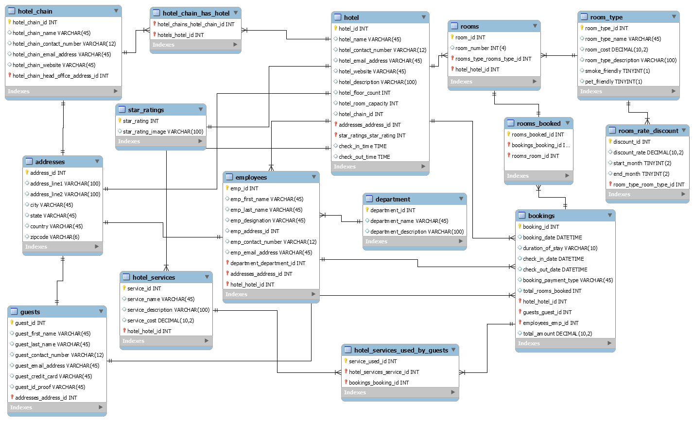
ERR DIAGRAM

Slide 6
Tables

Slide 7
Queries, Views, Triggers

Slide 8
THANK YOU
Pranav Mudigonda (AP22110010765
Sathvik Inguva (AP22110010748)
Chaturya L (AP2211001033)
Poojitha Naga Sai Repalle (AP22110010775)
Himanish Koneru (AP22110010735)

Slide 9

Overcoming nervousness

Slide 10
Selecting Visual Aids

Slide 11

Speaking Impact
Your ability to communicate effectively will leave a lasting impact on your audience
Effectively communicating involves not only delivering a message but also resonating with the experiences, values, and emotions of those listening

Slide 12
Dynamic delivery
METRIC | MEASUREMENT | TARGET | ACTUAL
Audience attendance | # of attendees | 150 | 120
Engagement duration | Minutes | 60 | 75
Q&A interaction | # of questions | 10 | 15
Positive feedback | Percentage (%) | 90 | 95
Rate of information retention | Percentage (%) | 80 | 85
Learn to infuse energy into your delivery to leave a lasting impression
One of the goals of effective communication is to motivate your audience

Slide 13
Final tips & takeaways
Practice makes perfect
Continue improving
Consistent rehearsal
Strengthen your familiarity
Refine delivery style
Pacing, tone, and emphasis
Timing and transitions
Aim for seamless, professional delivery
Practice audience
Enlist colleagues to listen & provide feedback
Seek feedback
Reflect on performance
Explore new techniques
Set personal goals
Iterate and adapt

Slide 14
Speaking engagement metrics
IMPACT FACTOR | MEASUREMENT | TARGET | ACHIEVED
Audience interaction | Percentage (%) | 85 | 88
Knowledge retention | Percentage (%) | 75 | 80
Post-presentation surveys | Average rating | 4.2 | 4.5
Referral rate | Percentage (%) | 10 | 12
Collaboration opportunities | # of opportunities | 8 | 10

